Slide 1
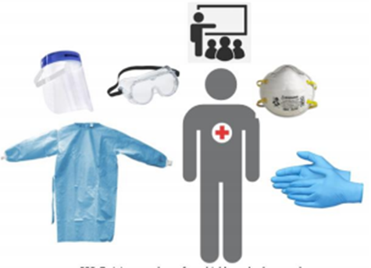
American Red Cross Updates for the COVID-19 Environment
A review of the new doctrines, new processes, and a new virtual world.

Slide 2
Mission of the American Red Cross
The American Red Cross prevents and alleviates human suffering in the face of emergencies by mobilizing the power of volunteers and the generosity of donors

Slide 3
Red Cross Response in a COVID-19 Environment
Priorities
Our mission has not changed. How we deliver the Red Cross Mission has changed.
The safety of our workforce and clients is a paramount concern.
Use of non-congregate settings for sheltering clients is preferred during this pandemic.
“ Everyone is Welcome” commitment has not changed

Slide 4
Non-Congregate Sheltering I
“Shelters” may include hotel/motel, RV campgrounds, single family cabins, tents
May include Reception Centers in the immediate aftermath
COVID-19 screening is a priority, but maybe limited in reception center environment
Goal is to get clients to a safer single room or cabin as quickly as possible.
Our mission has not changed. Only the way we accomplish our mission has changed

Slide 5
Non-Congregate Sheltering II
Screening may be conducted at the non-congregate site for responders and clients
Disaster Health Services conducts virtual wellness checks
Initial wellness check includes a C-MIST interview
Communicates relevant client needs to Shelter Site Manager

Slide 6
Non-congregate Sheltering III
If the wellness checks identify anyone with possible COVID-19 symptoms, clients will be asked to self-isolate in hotel rooms until public health or their healthcare provider gives them direction.
Red Cross will notify public health and ask for guidance
The shelter site manager will be notified
Disaster Health Services responders will continue to monitor client’s condition
CMIST interview is completed on all family units

Slide 7
Non-congregate services provided
Acquisition of hotels with ADA compliant rooms is a priority.
Red Cross Disability Integration specialists in collaboration with Disaster Health services responders assist disaster relief operations in meeting the needs of individuals with access and functional needs including those with disabilities.
Assistance with activities of daily living can be provided by disaster health services responders ( licensed healthcare providers), contracted personal care assistants, Home Health providers or client’s own personal assistance caregiver. Personal protective equipment is available to these caregivers.
Needed supplies such as: adult briefs, infant diapers, comfort kits, replacement of medication, DME , or Consumable medical supplies are available.

Slide 8
Non-congregate services
Unique diets will be provided.
Safe sleep options for infants and toddlers will be available if not provided by the non-congregate setting.
Translation services and assistive technology will be available or acquired when need is identified.
Information dissemination, such as status of client’s home area, re-entry instructions, available community recovery programs, FEMA registration or Red Cross recovery programs will be delivered to clients through multiple modalities including, but not limited to text or email.

Slide 9
Challenges
Geographic location of hotels: In order to acquire the needed hotel rooms the location of hotels might be widespread.
Isolation of clients: Clients will need to be more proactive in their own recovery journey to notify Red Cross of their needs.
High touch environment: Clients are contacted multiple times for different reasons by responders. Casework, Disaster Health Services, Disaster Mental Health may contact the household primary contact multiple times. This can create a Big Brother environment and cause resentment by the household.
COVID-19 Environment: Skinny staffing is a reality. Non-compliance of wearing masks creates fear both for clients and responders.

Slide 10
Lessons Learned Already I
Everything takes longer in the COVID-19 environment.
Disaster Response Operational leadership will mostly be virtual which has a learning curve.
Personal Protective Equipment (PPE) might not be in the right place during the immediate response phase.

Slide 11
Lessons Learned Already II
Distribution of meals is different and requires different vendor collaboration.
Pet care must be factored into the equation for hotel acquisition.
Signage is harder to place in the non-congregate setting.

Slide 12
Lessons Learned Already III
Contract staff may be needed to meet needs and this process takes time and requires on the ground supervision.
Red Cross Recovery Programs will need to use more virtual options. In person client casework will require a higher level of protection for client and responder.
Local and state Public Health entities are stretched and may not have the capacity to assist with testing, screening or contact tracing.
Both clients and responders have differing views of when and where to wear face coverings.
Social distancing to 6 ft. is hard and is difficult to calculate the 6 ft. distance.

Slide 13
Congregate Sheltering
Inevitable if large hurricane or wildfire occurs: WE ARE HERE.
Evacuation centers : 60 sq. ft. per individual
Congregate shelters post impact: 110 sq. ft per individual
Screening and isolation care areas will be established.
Only Disaster Health Services responders work in Isolation Care areas in full PPE.
Local Public Health Agency will be notified of each client in Isolation Care area.
Cuts shelter capacity by half.

Slide 14
One Way Drop Off of Supplies
Tornado/Flood/Fire
Event caused need for emergency sheltering
Less than 14 days
Public Health NOT Present
Shelter cannot be opened until isolation care area is resourced and operational
Friends and Family
Healthcare Facility
Shelter Size = 50 People Max​
Families can be together​
​
Everyone leaving facility​
must be rescreened upon return​
​
Normal Shelter process ​
with more entertainment​
​
Red Cross Team of 5 (+2)​
SM, Safety, Health, Log/Staff, MC
​
Isolation Area​ with
Additional Care Staff separated with barrier
Screening ​
Two Red Cross Screeners
Shelter Registration
Barrier/Door
Isolation Care Area
Clients who Develop Symptoms or are Confirmed
Symptoms Confirmed
Barrier/Door

Slide 15
Staffing
In Red Cross managed shelters, every effort will be made to have 50 or fewer clients in these shelters.
A Red Cross “ shelter strike team” consisting of a shelter manager, shelter supervisor, two shelter workers and one disaster health services responder will staff Red Cross managed shelters. Two additional disaster health services responders will be added to the team if an isolation care area is needed.
Clients will be recruited to assist with the management of the shelter.

Slide 16
Portable showers/toilets
Window
Window
Exit
Handwashing Station
Table
Table
Cot
Chair
Cot
Chair
Cot
Chair
Refuse
Handwashing Station
Refuse
Refuse
Restrooms
Restrooms
Cot
Chair
Cot
Chair
Cot
Chair
Table
Table
Handwashing Station
Entrance
CDC Poster
Table for Staff Possessions
PPE Storage
CDC Poster
Donning Area
Handwashing Station
Seating for Doffing
Refuse

Slide 17
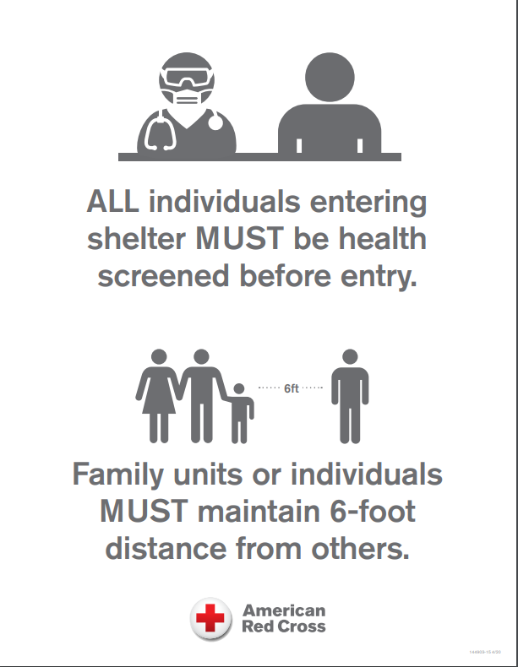
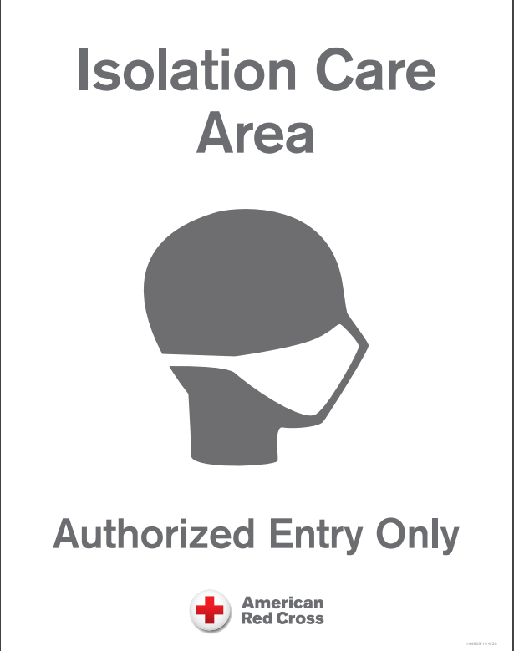
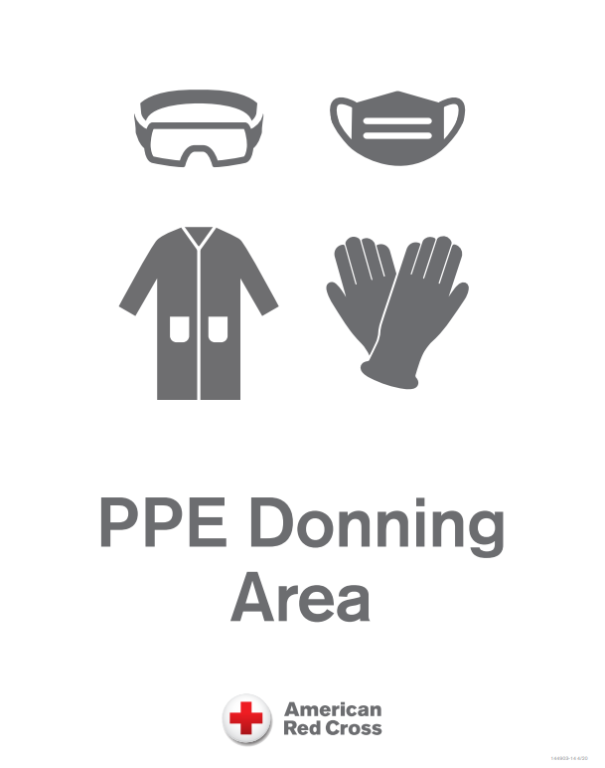
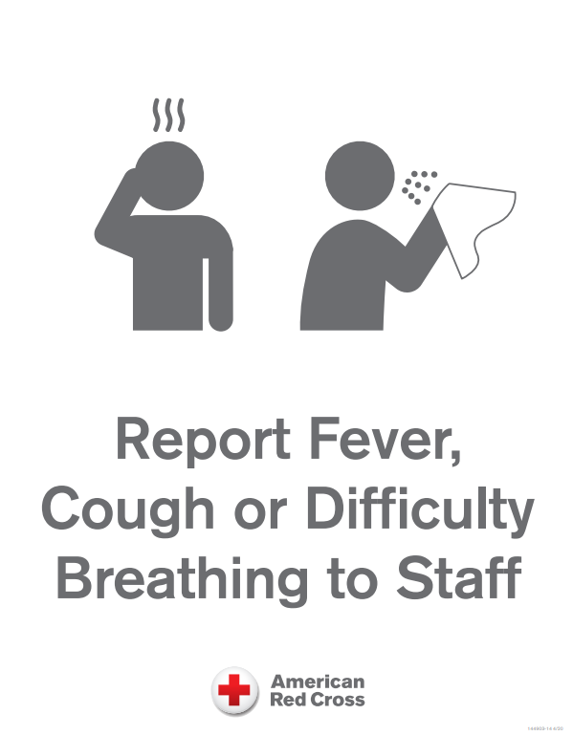
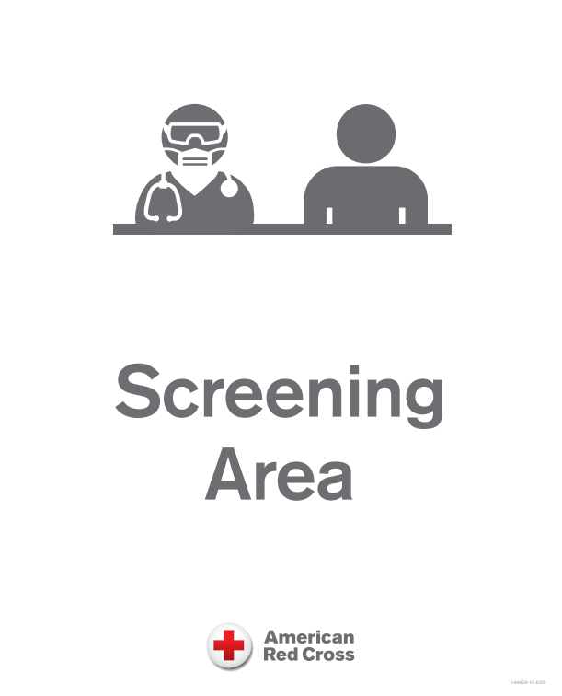
Signage

Slide 18
Challenges
Clients and responders may feel uneasy in a setting with many people.
Wearing of face coverings is required by both clients (over age 2) and responders.
Use of restrooms while practicing 6ft. physical distance is difficult and can decrease restroom and shower capacity.
Continual screening of those coming in and out of the shelter is labor intensive and intrusive. Weather is a complicating factor.
State and local public health entities may not be available for screening or work in isolation care areas.

Slide 19
Lessons Learned Already
Congregate shelters will happen.
The use of face coverings is required.
Emergency management and public health entities are stretched due to COVID-19 response alone and adding a disaster to COVID-19 response is difficult.
Feeding requires a different set of skills to produce single wrapped meals delivered with 6ft. physical distance.
The COVID-19 environment makes response and recovery harder and takes longer.

Slide 20
Responder Health I

Slide 21
Responder Health II
Critical to disaster Relief Operations.
All Disaster Health Services responders (virtual or on site ) will act as Staff Health
Workers on site will be screened before entering work site
Workers will be directed not to report to their worksite if they are ill for ANY reason. Staff Health will then follow–up with worker.
American Red Cross has an internal process to report COVID-19 employees or responders.

Slide 22
What Hasn’t Changed?
Red Cross disaster Relief Operations commitment to diversity and Inclusion: Everyone is Welcome. No individual with access or functional needs will be turned away from Red Cross non-congregate or congregate shelters.
Red Cross commitment to work closely with local and state Public Health to maintain the optimal health of staff and clients.

Slide 23
We are all in this TOGETHER

Slide 24
Mary Casey-Lockyer MHS,BSN,RN,CCRN Mary.CaseyLockyer@redcross.org Red Cross Disaster Health Services Program Lead for National Headquarters.

